Slide 1
Smithgall Woods Park Website
Project Update
MIST7591E – MBT Project II
Andrea Castresana
Jennifer Lazo
Alexander Couch
Clark Williams
Eliseo Santos
January 24, 2018

Slide 2
Overview
Project Background
How WordPress Works
Selected Theme for Main Site
Volunteer App
Available Plugins & Limitations
Alternative Solution to Volunteer App
Project Schedule
Way Ahead

Slide 3
Project Background
Problem
Difficult to update/maintain site and Volunteer app
Outdated PHP, WP themes and plugins
Degraded site security
Solution
Rebuild site using current WordPress/PHP
Site hosting either 1&1.com or Bluehost
Establish detailed Admin Documentation
Train FSGW Reps
Notes:
Criteria for website hosting:
Code must be accessible and portable
Cost must be below $20
Site security must be include SiteLock and SSL Certificate

Slide 4
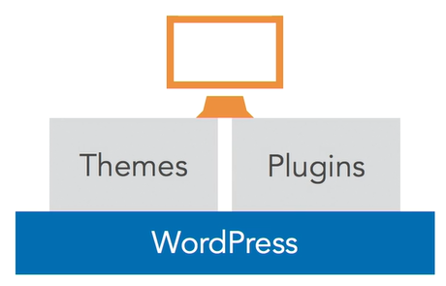
How WordPress Works
WordPress Core
Custom Appearance (Themes)
Custom Features & Functionality (Plugins)
Notes:
One of the great things about WordPress is the ability for developers to extend the core functionality of the code base to do just about anything you can think of. So we've got WordPress Core, and that's a stable code base that you can use as a platform to build your site. If you need to add custom features or functionality, instead of directly editing WordPress Core, you use plugins.
WordPress also gives us a way to change the appearance of a website, and that's done through themes. So we've got themes and plugins, where themes control the look of a site and plugins control any site-specific functionality that's needed in addition to WordPress Core.

Slide 5
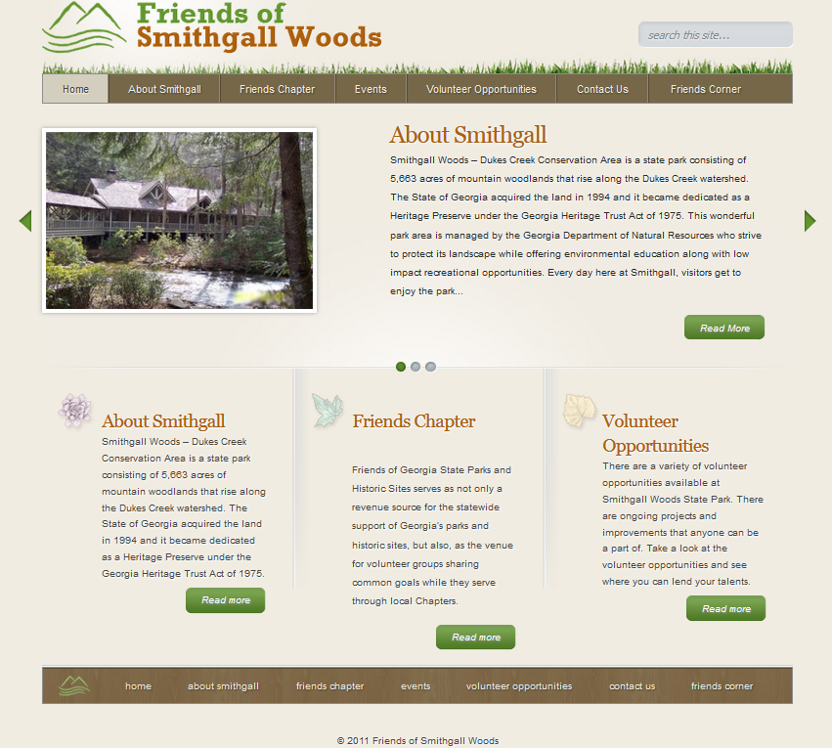
Existing Website

Slide 6
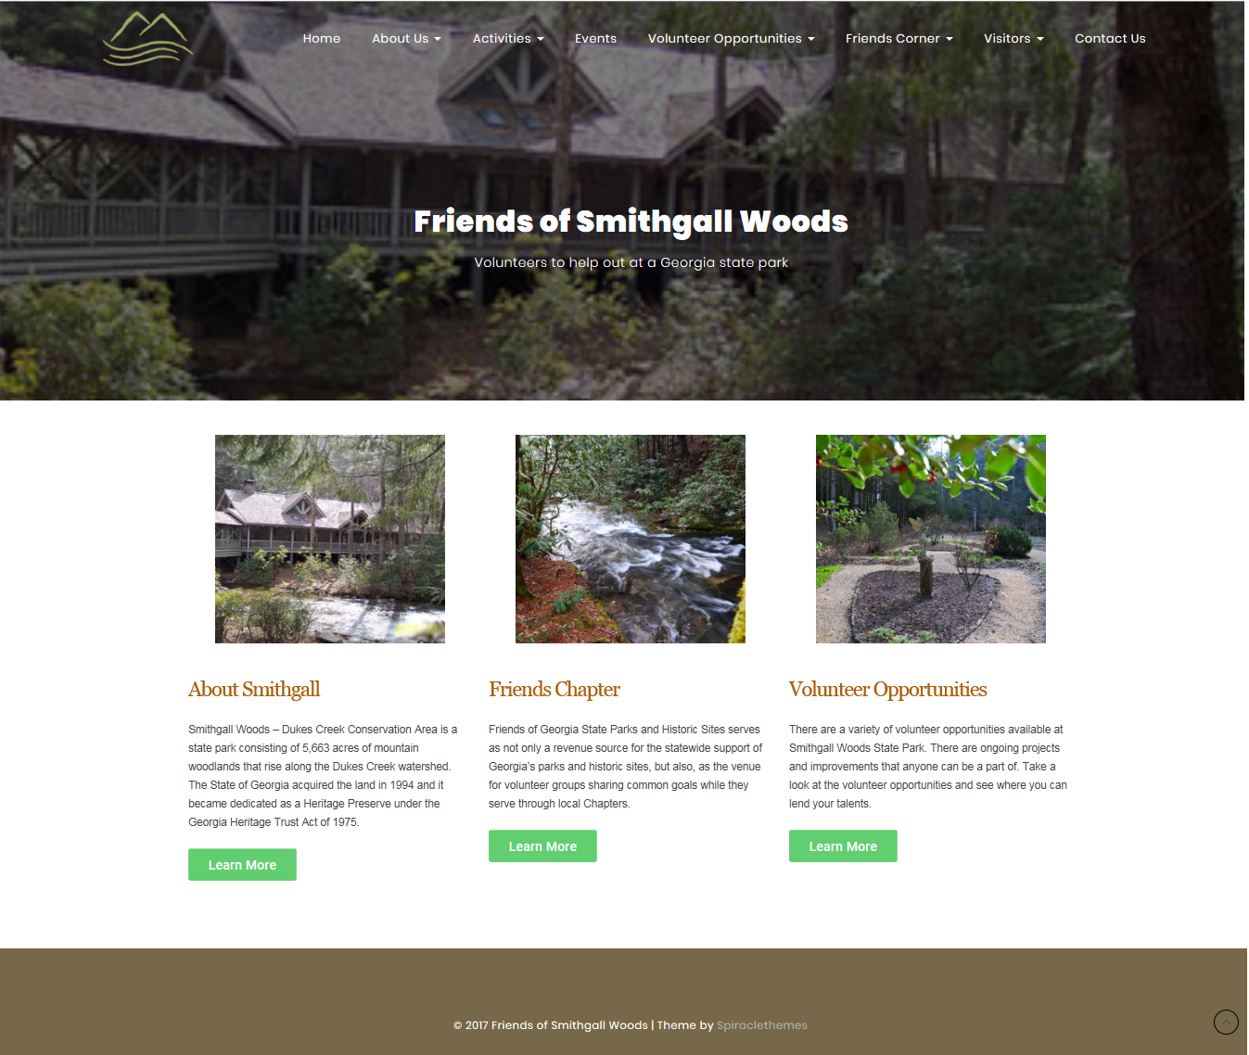
Selected WP Theme

Slide 7
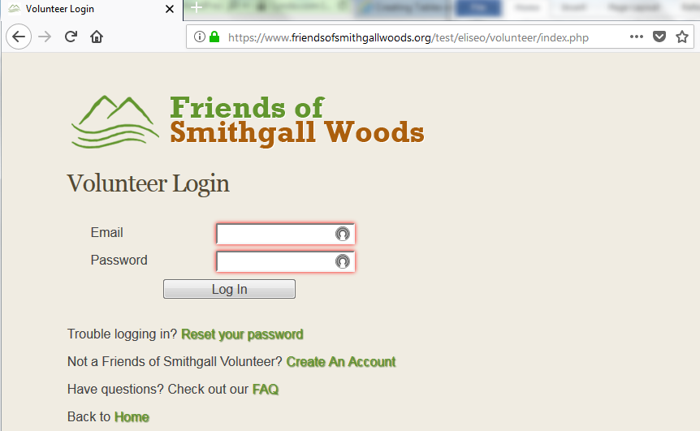
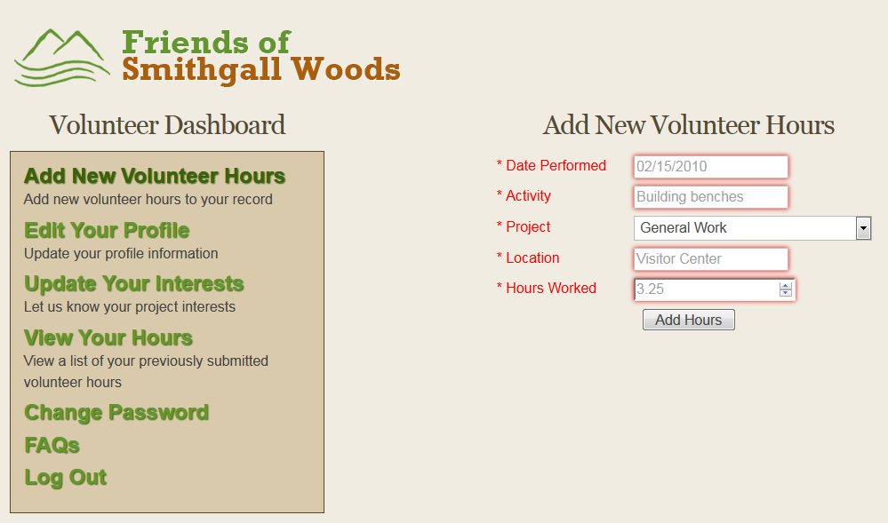
Existing Volunteer App
Stand-alone app linked from WP site

Slide 8
Available Plugins & Limits
Plugins use the built-in WP Database
Non-customizable database tables
Will not allow migration of the app DB tables
Negative impact to Volunteer App & Reports App
Notes:
The available plugins have some limitations. Since WP uses a built-in database that is established during the initial setup, it prevents you from altering the DB table structure. Some plugins add their own tables to the WP DB.

Slide 9
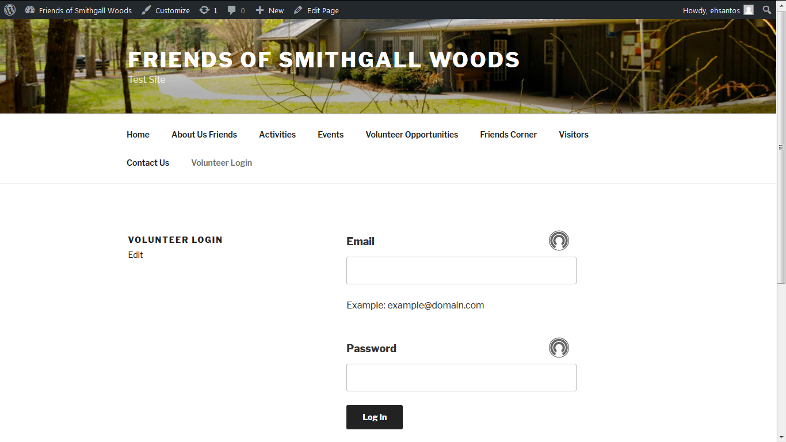
Alt. Solution to Volunteer App
Embedded Login Page on Example Theme

Slide 10
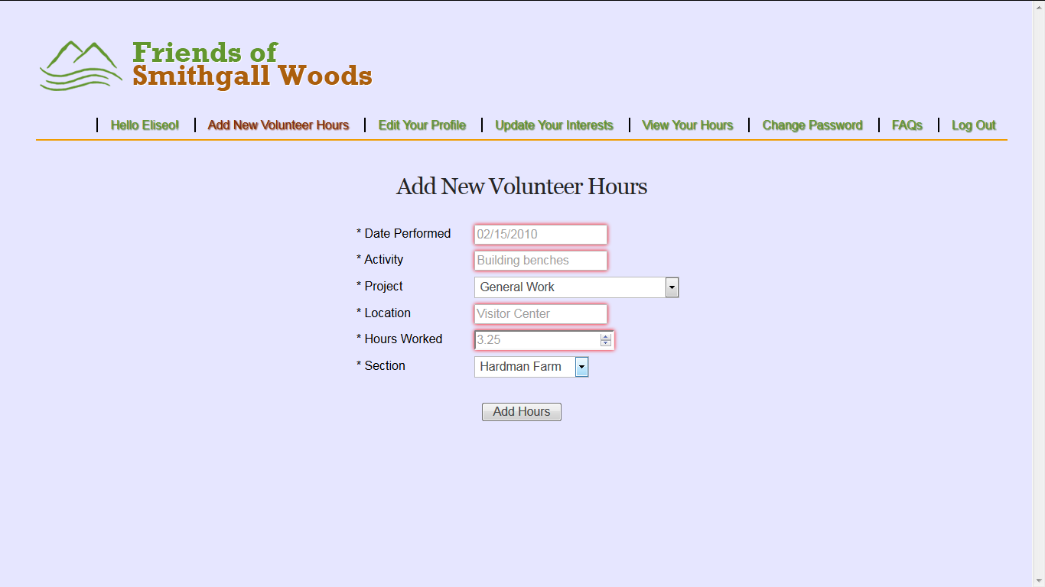
Alt. Solution to Volunteer App
Added Section Field for Hardman Farm & SGW
Added Navigation Bar & Login Name

Slide 11
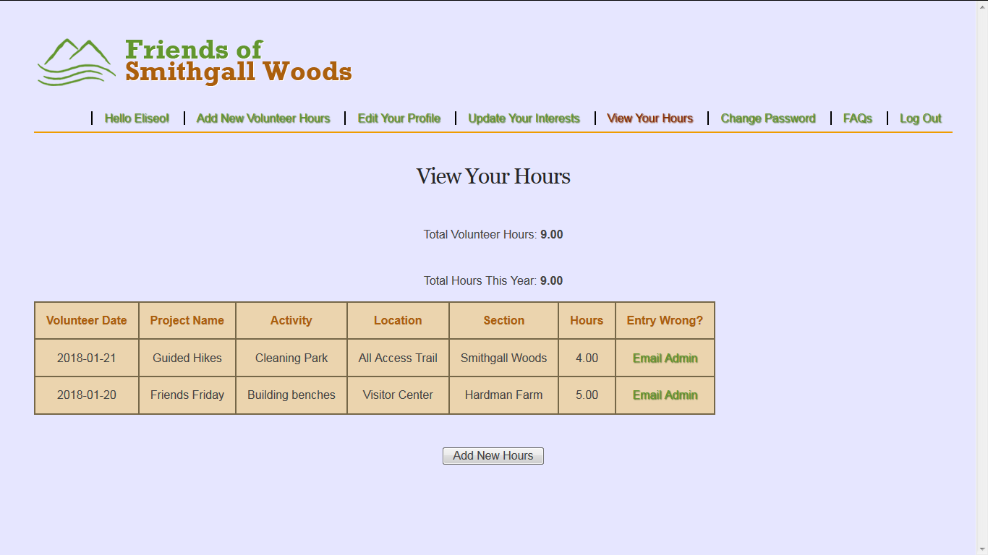
Alt. Solution to Volunteer App
Volunteer Hours View with added Section Field

Slide 12
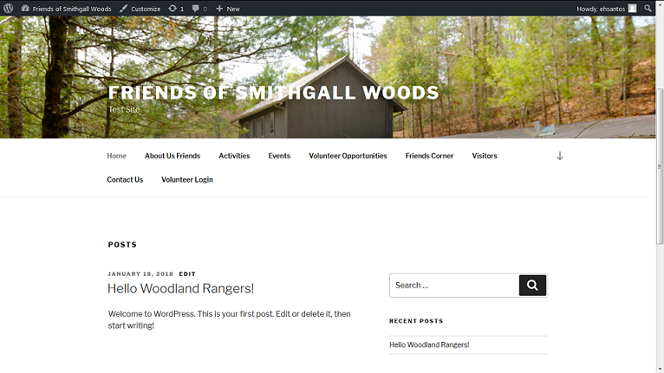
Alt. Solution to Volunteer App
Returns to Home Page after Log Out

Slide 13
Project Schedule
 |  | CY2017 |  |  |  | CY2018
Task Phase | Task Description | S | O | N | D | J | F | M | A
Initiation & Planning | 1. Conduct System Analysis of Current Site
 | 2. Propose Security Remediation Plan
 | 3. Establish Proposed System Requirements
 | 4. Meet with Project Stakeholders
 | 5. Develop Logical Models
 | 6. Conduct Testing of WordPress / Prototype
 | 7. Research Web Content Management Tool
 | 8. Finalize Requirements & Project Charter
Project Execution | 9. Start Rebuilding the Website/Volunteer App
 | 10. Test First Increment Version of Site/App
 | 11. Finish Rebuilding the Entire Site/App
 | 12. Test Final Rebuild of Website/App
Project Closure | 13. Establish Documentation
 | 14. Deploy Production Version of Website
 | 15. Conduct Training on Website Maintenance
 | 16. Hold Project Closure Meeting with Client

Slide 14
Way Ahead
Continue customizing site content with theme
Look into building a plugin for Volunteer App
Update Volunteer App code to PHP 7.2
Resolve MySQL deprecation by using MySQLi or PDO_MySQL extension
Notes:
Train all team members on WordPress & PHP
Tutorials by LearnWebCode & Lynda.com
Assign site rebuilding tasks to each team member; rebuild is consisted of 3 parts
Main SGW Website
Volunteer Hours Log App
Volunteer Reports App (Secondary site)
Begin rebuilding website in December

Slide 15
Questions

